Slide 1
Introduction to EQuIP
Philipp Neuerburg, Denisse Navarro & Andrea Heredia
12th November 2018
Bonn, Germany

Slide 2
This presentation
The Industrial Policy Challenge
Our answer: the EQuIP approach
Overview of the EQuIP tools
Q&A

Slide 3
1. The Industrial Policy challenge

Slide 4
Industrial Policy is back on the agenda
The question is no longer whether or why industrial policies should be deployed in the first place, but “what”, “when” and “how” they can be designed and implemented more effectively.
The scope of the strategies has broadened beyond a focus on growth and must now consider an integrated social, environmental and economic landscape of interventions.
Notes:
Industrial policy formulation has reappeared as a central component of development strategies.
Despite this shift in the discourse, a key challenge for many developing countries is the lack of appropriate capacities.
Many developing countries are not yet in the position to independently manage an effective industrial policy process. However the significant gap of industrial policy design and management capacities in developing countries needs to be approached in a pragmatic way.
EQuIP approach focus on providing tools to support developing countries’ efforts to independently design context-appropriate industrial policy packages that can help them to achieve the structural transformation they envision.

Slide 5
What is Industrial Policy?
EQuIP definition:
  “Government promotion of structural transformation through support of economic activities that are perceived to be socially beneficial”
→ What type of structural transformation?
→ What is socially beneficial?

Slide 6





Common challenges in Industrial Policy design
Policy documents “fall from the sky”
Lack of strategic focus on objectives
Decisions are rarely based on evidence
Notes:
A key challenge for many developing country governments is a shortage of adequately trained national analysts leading to an extensive dependency on international advisers and, thus, the lack of appropriate capacities to follow an industrial strategy formulation process.
Lack of engagement

Slide 7
As a result…
There is a large dependency on external advice (development partners or national experts/consultants)
Policy design often begins with “one-size-fits all” instruments rather than objectives.
Lack of consideration for broader national development context: industrial policy is not aligned with other policy areas.
Lack of ownership (and full understanding) of analytical results, which often inhibits fully devoted course of actions
Contradictions between different pieces of analytics & advice

Slide 8
But there is no blue print…
Each country has its own
Unique context
Priorities
Objectives
Notes:
--> In development, too often consultants purposely use complicated models and jargon to intimidate the counterparts so as to ensure passive acceptance of their “expertise”. As a result, there is no questioning or engagement.

Slide 9
2. The EQuIP approach

Slide 10



…since 2014!
→ www.equip-project.org

Slide 11
How to make Industrial Policy effective?
EFFECTIVE INDUSTRIAL POLICY
SELF-DETERMINED (TAKE CONTROL!)
EVIDENCE-BASED
(STAY INFORMED!)
GOAL-ORIENTED
(BE STRATEGIC!)

Slide 12
As a result…
Traditional approach
EQuIP approach
(self-determined)
Objective: Best possible policy document
Responsibility: International expert taking lead
Priorities: growth and export competitiveness
Challenge: limited implementation, no sustainability
Self-sufficient policy-making process
Building local capacities for industrial policy design
Recognize multi-dimensional nature of development
Fully owned policy that will be implemented

Slide 13
3. The EQuIP tools

Slide 14
EQuIP methodology: from analysis to policy design
EQUIP ANALYTICAL TOOLBOX
  Provides evidence as foundation for priority setting
EQuIP 1
EQuIP 2
EQUIP POLICY DESIGN TOOL
  Structures process to assess and select industrial policy instruments

Slide 15
EQuIP methodology: from analysis to policy design
EQuIP 1
EQuIP 2
Industrial Analysis / Diagnosis
Training of national analysts in key concepts & intuitive indicators
Understand the performance of the Industrial Sector across social, economic and environmental dimensions
Create solid evidence & identify opportunities
Set strategic targets for the future

Slide 16
EQuIP analytical tools
Multi-dimensional industrial performance analysis
Social
Economic
Social inclusiveness
Industrial competitiveness and economic performance
Industrial Policy
Environment
Environmental sustainability

Slide 17
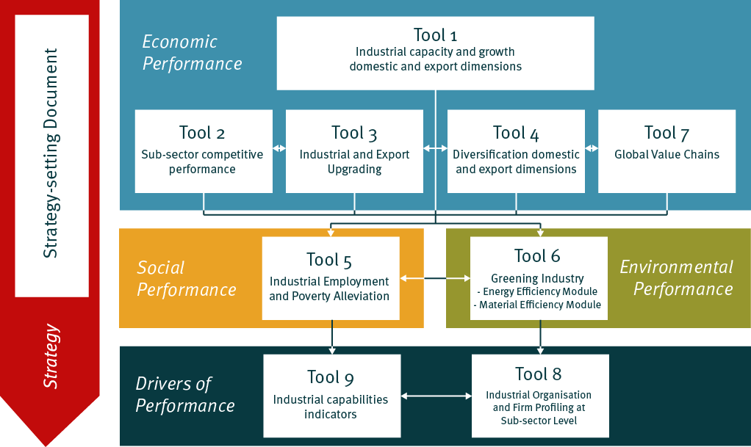
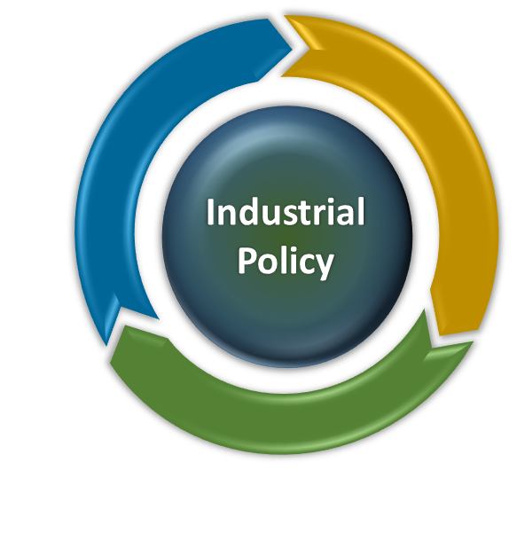
EQuIP 1. Industrial Analysis: Overview of tools
Notes:
EQuIP uses international databases with good data availability (the best data available for these indicators globally)
Generally speaking, trade data is more easily available than production data (WITS>WDI>INDSTAT)

Slide 18
Some examples from EQuIP analytical toolbox
Expansion of industrial production
Export competitiveness in manufacturing
Industrial upgrading (towards higher technology)
Diversification (products and markets)
Productive employment generation
Wage performance
Informal sector performance
Gender dynamics
Industrial energy-efficiency
Material efficiency
Self-sufficiency (energy and material)

Slide 19
EQuIP 1 toolbox: Example of analysis
e.g. “Industrial upgrading”
Intuitive quantitative indicator
e.g. “medium and high-technology share of MVA”
Data from international database
e.g. UNIDO INDSTAT database for global industrial statistics
Quantitative analysis & interpretation
Policy implications of analysis
Industrial performance concept
Setting a target for future performance
e.g. Compare sophistication of industrial production with a role model country over a 10 year period
e.g. Need to enhance technological intensity of industrial structure to boost competitiveness
e.g. Medium and high tech share of MVA to increase by 10% in the next 5 years

Slide 20
Example of analytical finding
Industrialization intensity for Vietnam and comparators

Slide 21
EQuIP methodology: from analysis to policy design
EQuIP 1
EQuIP 2
Industrial Policy Design
Goal-oriented industrial policy design process
Develop systematic intervention logic for a country
Assess and select policy instruments
Ensure context-specific and coherent policy package
Institutional assessments

Slide 22
EQuIP Industrial Policy design
“The conscious attempt to define industrial policy objectives and connect them to the industrial policy instruments expected to realize those objectives”
IP Objectives
What kind of structural transformation?
IP Instruments
Regulations
Incentives
Information
Public ownership
Economic, social and environmental considerations

Slide 23
EQuIP 2: From Analysis to Industrial Policy Design
Analytical foundations from EQuIP 1
Link IP to National Development Goals
1
The EQuIP 2 industrial policy design process
Define industrial policy objectives
2
Select intervention areas & target groups
3
Consider industrial policy instruments
4
Notes:
Why do we need evidence-based IP:
A strategic approach to IP requires the selection of some priorities over others
Making these choices is difficult and requires a systematic approach
Using evidence for decision-making is key
-Where do we stand today?
Where do we see opportunities?
How are other countries doing?
Where can we go in the next 10 years?

Slide 24
EQuIP 2. Industrial Policy Design
Link IP to National Development Goals
Identify clear priorities for action
Define which national development objectives can effectively be pursued by IP
Analyse which complementary policies are crucial to ensure success of IP
1
Define industrial policy objectives
2
Select intervention areas & target groups
3
✓
Ensures a context-appropriate industrial policy package which is aligned to national priorities
Consider industrial policy instruments
4
Notes:
Why do we need evidence-based IP:
A strategic approach to IP requires the selection of some priorities over others
Making these choices is difficult and requires a systematic approach
Using evidence for decision-making is key
-Where do we stand today?
Where do we see opportunities?
How are other countries doing?
Where can we go in the next 10 years?

Slide 25
EQuIP 2. Industrial Policy Design
Link IP to National Development Goals
Consider various policy orientations in multi-stakeholder process
Prioritize key objectives to be pursued (not “shopping list approach”)
Communicate strategic relevance of priorities
Clarify synergies and trade-offs among objectives
Set concrete quantitative impact targets
1
Define industrial policy objectives
2
Select intervention areas & target groups
3
Consider industrial policy instruments
✓
Ensures objective-oriented industrial policy package with clear impact logic
4
Notes:
Why do we need evidence-based IP:
A strategic approach to IP requires the selection of some priorities over others
Making these choices is difficult and requires a systematic approach
Using evidence for decision-making is key
-Where do we stand today?
Where do we see opportunities?
How are other countries doing?
Where can we go in the next 10 years?

Slide 26
EQuIP examples of IP objectives
INCREASE
PRODUCTIVE ACTIVITIES
DEEPEN GLOBAL
MARKET INTEGRATION
MAXIMIZE
DOMESTIC BENEFITS
GENERATE PRODUCTIVE EMPLOYMENT
IMPROVE QUALITY
OF EMPLOYMENT
ENSURE
EQUITABLE PRODUCTION
BUILD
ECONOMIC RESILIENCE
PROMOTE
SELF-SUFFICIENCY
IMPROVE
RESOURCE-EFFICIENCY
REDUCE
POLLUTION
EQuIP: There is no single “right” IP objective!
Objectives have to be defined on the basis of national context and will shape the structural transformation pattern
Notes:
In working in industrial policy, these are some of the most common IP objectives we have encountered. In practice, countries define their own IP objectives but we use these 10 to help stimulate discussion and to help countries consider a broad range of potential objectives.

Slide 27
EQuIP 2. Industrial Policy Design
Link IP to National Development Goals
Identify key bottlenecks to be lifted to achieve objectives
Define concrete changes that need to be achieved in the productive sector
Define key economic actors who are targeted by the policy (incl. priority sectors)
Consider impact on beneficiaries and potential adverse effects of interventions
1
Define industrial policy objectives
2
Select intervention areas & target groups
3
Consider industrial policy instruments
✓
Evidence-based selectivity allows for a realistic definition of areas for intervention
4

Slide 28
EQuIP 2. Industrial Policy Design
Link IP to National Development Goals
Identify options for concrete government interventions
Build on the basis of existing instruments
Learn from international best practice, but don’t copy & paste “silver bullets”
Prioritize instruments with high impact and high feasibility for implementation
Encourage experimentation
1
Define industrial policy objectives
2
Select intervention areas & target groups
3
Consider industrial policy instruments
✓
Focused and coherent package of feasible instruments for intervention
4

Slide 29




4 types of policy instruments
REGULATIONS
INCENTIVES
INFORMATION
PUBLIC OWNERSHIP
Formulated rules and directives that mandate economic actors to act in accordance
The handing out or taking away of material resources to encourage certain behaviors by economic actors
The collection, dissemination and publication of information to promote particular economic activities
Government’s establishment of enterprises and direct supply or demand of particular goods & services
.

Slide 30
EQuIP in the policy cycle
CONDUCTING
INDUSTRIAL DIAGNOSIS
DEFINING
STRATEGIC PRIORITIES
DESIGNING AN INDUSTRIAL
POLICY PACKAGE
IMPLEMENTING INDUSTRIAL POLICY INSTRUMENTS
MONITORING & EVALUATING
POLICY IMPACT
Institutional Set-up
Notes:
EQuIP is formulated around the notion of industrial policy cycle

Slide 31
EQuIP in the policy cycle
CONDUCTING
INDUSTRIAL DIAGNOSIS
DEFINING
STRATEGIC PRIORITIES
DESIGNING AN INDUSTRIAL
POLICY PACKAGE
IMPLEMENTING INDUSTRIAL POLICY INSTRUMENTS
MONITORING & EVALUATING
POLICY IMPACT
EQuIP 1
Assess industrial performance (social, economic, environmental)
Benchmark analysis relative to other countries
Identify current strengths & weaknesses
Develop industrial intelligence reports
Establish national database of indicators
Institutional Set-up
Notes:
EQuIP is formulated around the notion of industrial policy cycle

Slide 32
EQuIP in the policy cycle
EQuIP 1
EQuIP 2
CONDUCTING
INDUSTRIAL DIAGNOSIS
DEFINING
STRATEGIC PRIORITIES
DESIGNING AN INDUSTRIAL
POLICY PACKAGE
IMPLEMENTING INDUSTRIAL POLICY INSTRUMENTS
MONITORING & EVALUATING
POLICY IMPACT
Facilitate dialog and agree on policy priorities
Establish quantitative targets for prioritized IP objectives
Identify opportunities and risks related to industrial development
Adapt existing strategy to include new priorities
Institutional Set-up
Notes:
EQuIP is formulated around the notion of industrial policy cycle

Slide 33
EQuIP in the policy cycle
EQuIP 2
CONDUCTING
INDUSTRIAL DIAGNOSIS
DEFINING
STRATEGIC PRIORITIES
DESIGNING AN INDUSTRIAL
POLICY PACKAGE
IMPLEMENTING INDUSTRIAL POLICY INSTRUMENTS
MONITORING & EVALUATING
POLICY IMPACT
Facilitate “stock-taking” and review of existing policy instruments
Consider wide-range of different new instruments
Consider potential synergies & conflicts between instruments
Assess and select new instrument package on the basis of feasibility & impact
Institutional Set-up
Notes:
EQuIP is formulated around the notion of industrial policy cycle

Slide 34
EQuIP in the policy cycle
CONDUCTING
INDUSTRIAL DIAGNOSIS
DEFINING
STRATEGIC PRIORITIES
DESIGNING AN INDUSTRIAL
POLICY PACKAGE
IMPLEMENTING INDUSTRIAL POLICY INSTRUMENTS
MONITORING & EVALUATING
POLICY IMPACT
EQuIP 2
Support with iterative & learning approach to implementation
Definition of detailed action plans for policy instruments
Define required technical & budgetary resources
Assist with fund-raising by providing convincing logic/ justification
Institutional Set-up
Notes:
EQuIP is formulated around the notion of industrial policy cycle

Slide 35
EQuIP in the policy cycle
CONDUCTING
INDUSTRIAL DIAGNOSIS
DEFINING
STRATEGIC PRIORITIES
DESIGNING AN INDUSTRIAL
POLICY PACKAGE
IMPLEMENTING INDUSTRIAL POLICY INSTRUMENTS
MONITORING & EVALUATING
POLICY IMPACT
EQuIP 1
EQuIP 2
Establish quantitative M&E system to monitor progress towards targets
Define intervention logic and anticipated impact of individual IP instruments
Assess impact of interventions
Propose adaptations of policy package
Institutional Set-up
Notes:
EQuIP is formulated around the notion of industrial policy cycle

Slide 36
EQuIP in Action
East African Community: Building analytical capacity of member states to assess industrial performance
Mozambique: Review industrial strategy draft and establish monitoring system
Ukraine: Facilitate drafting of new industrial policy
Vietnam: Conduct assessment of priority sector’s performance (textiles, machinery & agro-processing)
Myanmar: Support with drafting of new Textile strategy and action plan
South Africa: Design M&E system to assess impact of large subsidy scheme for manufacturer’s

Slide 37
4. Q&A

Slide 38
Different applications for EQuIP
Need for new industrial policy
☑
Develop an industrial policy that reflects countries unique context, priorities and capacities
Self-dependency to conduct diagnostics to identify opportunities and options that can be considered in the process
☑
Review / update industrial policy
☑
Assess the strategic orientation of an existing industrial policy and instruments
Identify which instruments should be kept, changed and terminated
☑
Industrial policy in place
☑
Use this process to check the consistency of the policy package
Develop monitoring and evaluation framework for industrial policy
Align new IP instruments and donor interventions better to national priorities
☑
☑

