Slide 1
The UNIDO Department of Policy, Research and Statistics
Hanoi | Bonn, 15 November 2018
F. Brugger

Slide 2
Mission and Structure
Mission
Provide strategic policy advice based on sectoral analyses of industrial development and processes of structural change;
Develop UNIDO’s research programme, advocates sustainable industrialization;
Strengthen the capacity of Member States in related areas.
Structure
Division of Statistics
Division of Research and Policy Advice (incl. capacity development)

Slide 3
UNIDO Statistics – the core of research
Collecting and maintaining international industrial statistics based on the international standard of all economic activities (ISIC) at different levels
Monitoring SDG on industrialization progress (SDG 9)
The foundation for analysis of the patterns of structural transformation
understanding how the structure of the economy (employment, value added …) changes as income grows …
.. allows us to anticipate such transformations and prepare to them in the best possible way

Slide 4
Research
Industrial Development Report
Flagship publication (biannual) to address most pressing issues of ISID
Combining UNIDO’s own research and inputs from leading experts
Programme for Country Partnerships (PCP) diagnostics
Analytical base for the development of UNIDO’s PCPs
Assessing constraints and opportunities for ISID
Research projects and partnership
Joint research with universities and research institutes to expand the scope and scale of UNIDO’s research and advocacy
Staff research papers
Knowledge contributions to the areas of structural change, sustainability, global value chains, and FDI

Slide 5
Global Manufacturing and Industrial Summit (GMIS)
UNIDO and UAE
Global forum on the 4th Industrial Revolution (4IR)
Summits (2017, 2019, 2020, …)
Roadshows building up to the Summit

Slide 6
Support to design of industrialization policies
Linking policy to strategic objectives and targets
Assessment of industrial policies/laws/regulations/programmes on the basis of the following categorization:
Policies aimed at correcting market failures in product, labor, capital, land and technology markets (horizontal)
Policies aimed at promoting certain industrial activities (vertical)
Policies aimed at addressing governance and coordination issues
Tasks
Identification of individual policies and policy packages
Assessment of their effectiveness and costs
Identification of policy gaps and accordingly modify existing policies and/or introduce new ones
Policy learning

Slide 7
Capacity-development activities
Deliver training courses on the following topics:
Industrial statistics analysis and diagnostics
Industrial policy strategy formulation
Industrial policy instruments
Green Industry
Sustainable Energy Solutions
Science, Technology and innovation (STI)
Industry 4.0
Standards and National Quality Infrastructure
Industrial Parks
Global value chains
Foreign Direct Investment (FDI) and Trade
…

Slide 8
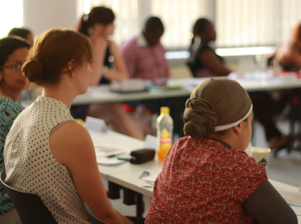
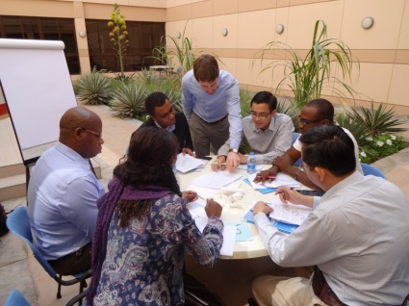
Different audiences / different formats
Global Executive Programme (high-level policymakers)
Professional Programme (mid-level policymakers & professionals)
Future Leaders Programme (younger stakeholders from the public and private sector, civil society and academia)
E-learning

Slide 9
UNIDO and EQuIP
UNIDO was involved in the design of EQuIP which includes some tools and methods developed and deployed previously (e.g. CIP)
EQuIP is now part of UNIDO‘s standard repertoire for analysis, capacity development and policy advice services
Answering requests from UNIDO Member States
Jointly approaching donors together with recipients
UNIDO and GIZ work together on updating and extending the EQuIP toolkit (currently: digitalization and gender)

Slide 10
Thank you ! Franz Brugger | f.brugger@unido.org

